Slide 1
Predicting When Popular Songs Were Made Based On Musical Qualities
By Joe Flatt
🎼 🎸

Slide 2
Exploring Musical Qualities
Can Machine Learning predict when a popular song was made based solely on musical qualities?
Popular music can be associated to different points in time by many different factors. This research will help determine if musical qualities are enough to categorize songs by the time period that they were made.

Slide 3
Motivation
My music background - BA in Music Business, guitar player for 17 years.
Curious if popular songs changed over the decades or if there are certain musical qualities that remained the same, thus contributing to the popularity of the songs.

Slide 4
Practical Use
If a record label wanted to produce a song that resembles the style of a certain time period, they could use these results to do so and thus make the song more attractive to a target audience.
For example - if a target audience of an artist likes classic rock, using song characteristics from the 70’s should help increase sales

Slide 5
Data
The dataset chosen was "Evolution of Popular Music: USA 1960–2010" by Matthias Mauch via figshare
My Jupyter Notebook
The dataset included basic information such as track names and artist names in addition to musical quality information.

Slide 6
Data
There were a lot of musical features included and converted to numeric values, which was extremely helpful in shaping the project.
“Popular music” in this research covers multiple genres (hip hop, jazz, rock, etc.) of music and includes more than “Pop” music.
Timbre is “the character or quality of a musical sound or voice as distinct from its pitch and intensity” - Google search dictionary.
Harmony is “the combination of simultaneously sounded musical notes to produce chords and chord progressions having a pleasing effect” - Google search dictionary.

Slide 7
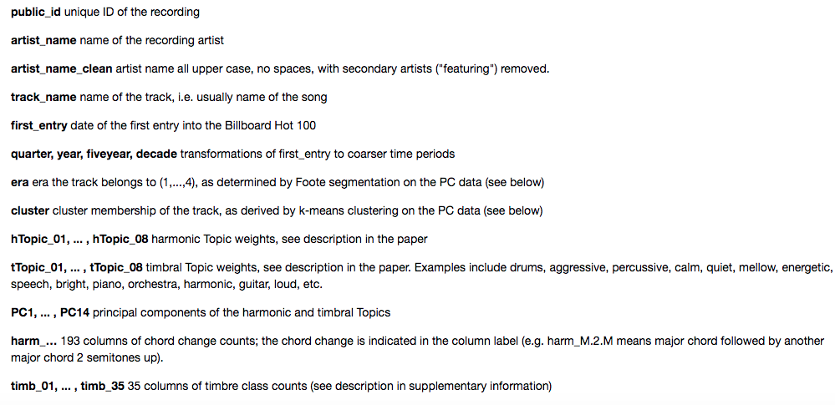
Data - Features

Slide 8
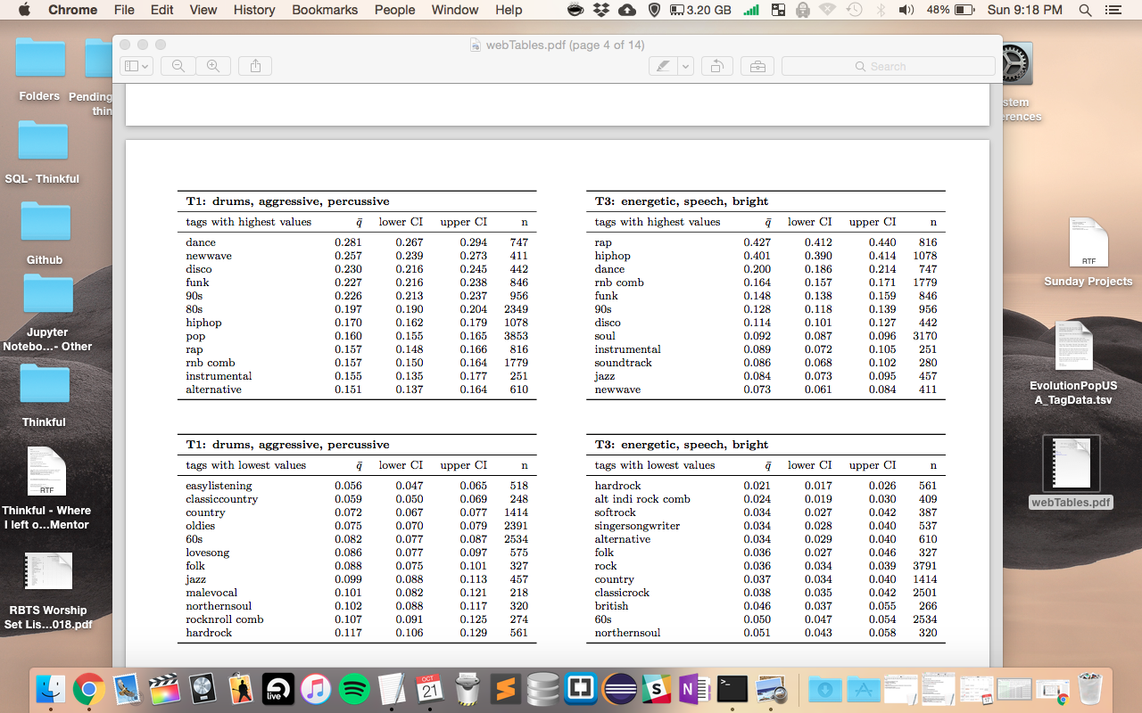
Data - Features

Slide 9
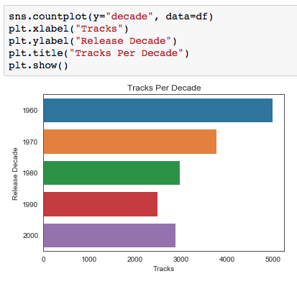
Data by Decade

Slide 10
Data
The research question is a classification problem. The original dataset has 17,094 rows and 269 columns.
After loading the dataset, I removed all non-musical quality columns.
This was a similar problem to the Credit Card Fraud exercise in Unit 3.

Slide 11
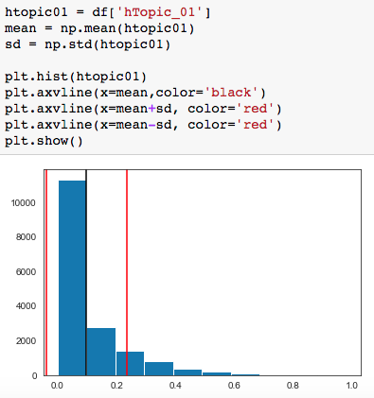
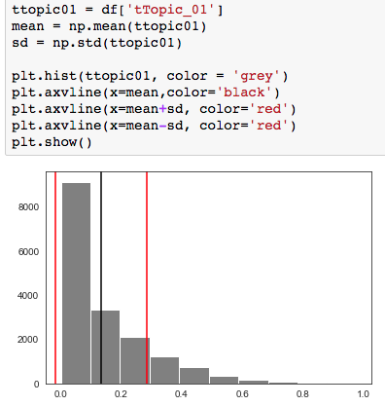
Data Distribution

Slide 12
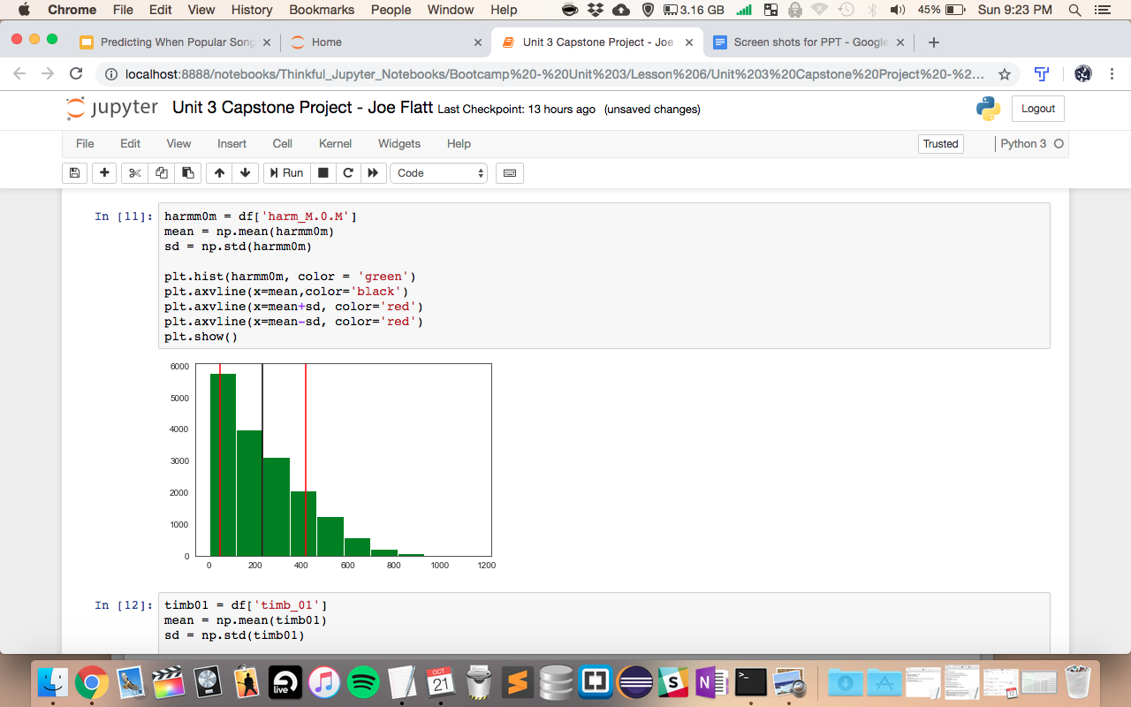
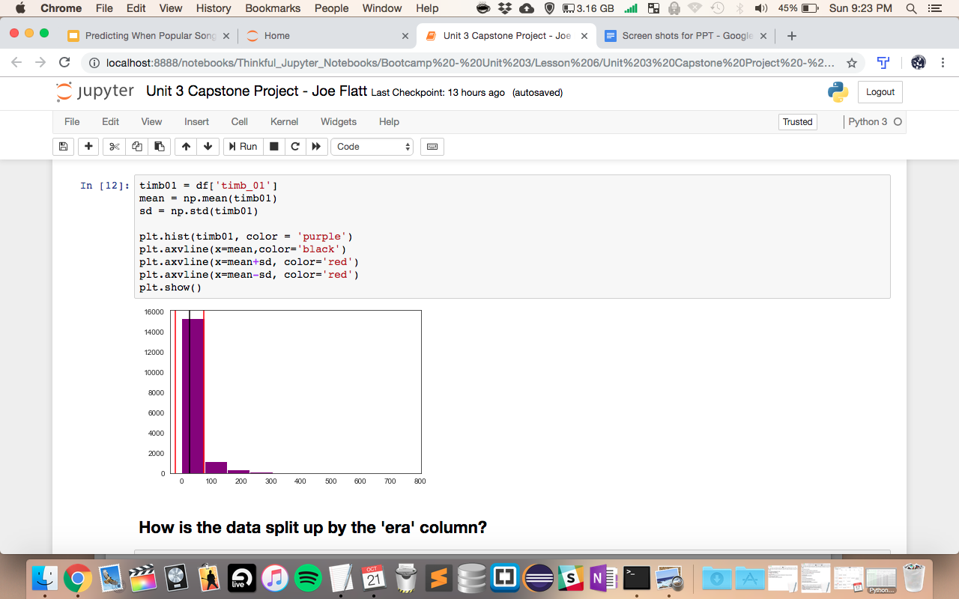
Data Distribution

Slide 13
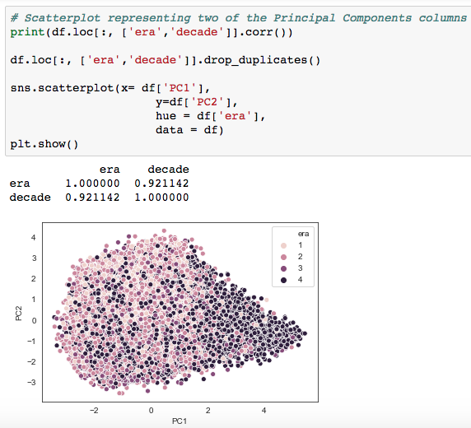
Data Distribution

Slide 14
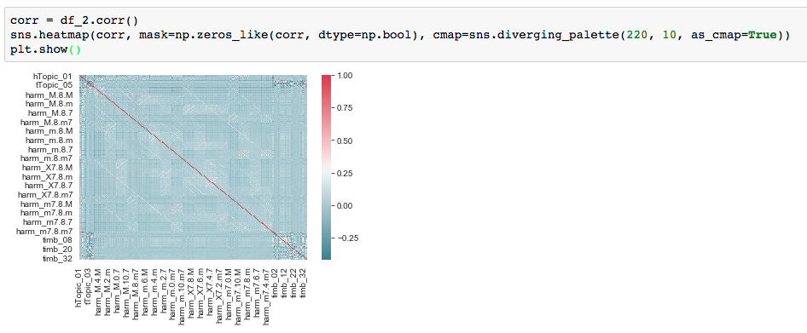
Data Distribution

Slide 15
Training Parameters
Trained on the ‘decade’ column.
Results were poor, so I tried training on the ‘era’ column.
Results were poor again, so I split ‘era’ into two sections rather than four sections.
Splitting ‘era’ into two sections helped to optimize results.
The following models were used on all testing: Decision Tree, Random Forest, and KNN Classifier.
Each model used a 20% holdout group to combat overfitting.

Slide 16
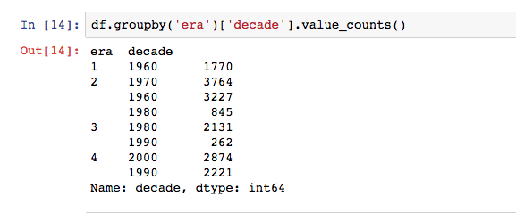
Training Parameters
Split era’s 1,2,3,4 into (1,2) & (3,4)

Slide 17
Decision Tree & Random Forest Results
The test model cross validation scores averaged 58% for the Decision Tree and 73% for the Random Forest.
To further test and improve, I used feature importances.
From the feature importances, I chose the top ten features and ran the Decision Tree and Random Forest models again.
The results were similar:

Slide 18
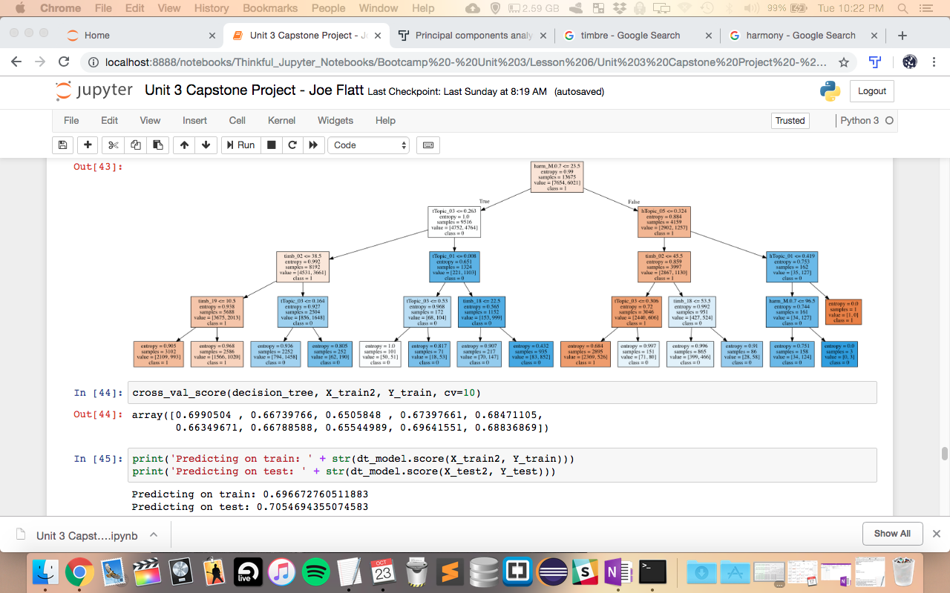
Decision Tree

Slide 19
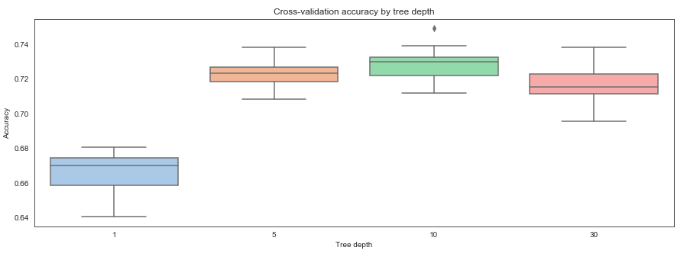
Random Forest

Slide 20
KNN Classifier
Since this is a classification problem, I ran a KNN Classifier for further verification.
The results were similar to the Random Forest findings:

Slide 21
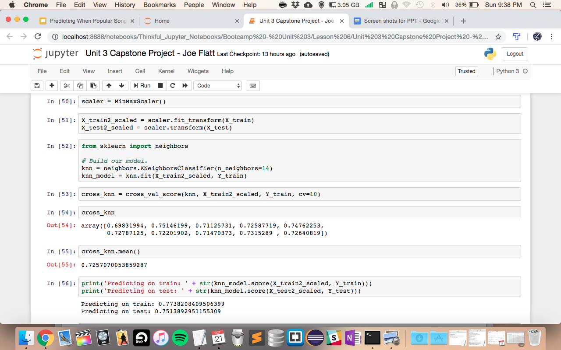

Slide 22
Comparing Results

Slide 23
Challenges
Making sure non-musical columns were not included was very important.
Musical qualities were not distinctive enough over the decades.
Musical quality numbers went through processing that was done prior to this exploration.

Slide 24
In Conclusion
Predicting when popular songs were made based on musical qualities is possible.
For this particular dataset, the musical qualities were not distinctive enough over the decades, so broadening the parameters yielded more optimized results.
Further exploration could lead to better results; however, by broadening the ‘time’ parameters, satisfactory results were accomplished.
🎼 🎸

